Slide 1


Workforce Education and Training in Software Assurance and Supply Chain Risk Management
Joe Jarzombek, PMP, CSSLP
Director for Software Assurance
National Cyber Security Division
Office of the Assistant Secretary for Cybersecurity and Communications
Dr. Robin Gandhi
Assistant Professor
of Information Assurance
University of Nebraska at Omaha
March 17, 2011
Notes:
Need for “Assurance” to be advanced as part of CMM-based process improvement and capability appraisal
Security, Safety, and Dependability
Related efforts
Need for advancing standards supporting Assurance Case (Arguments/Claims)
Scaling and bounding
Lifecycle support
Role of related evaluation schemes

Slide 2
Technologies Subject to Exploitation: Providing Context for the Priority of Common Weaknesses
Technology Groups | Archetypes
Web Application | Web browser, web-server, web-based applications and services, etc.
Control System | SCADA, process control systems, etc
Embedded System | Embedded Device, Programmable logic controller, implanted medical devices, avionics package
End-point Computing Device | Smart phone, laptop, and other remote devices that leave the enterprise and/or connect remotely to the enterprise
Cloud Computing | Software-enabled capabilities and services (either installed locally or offered via hosted services/cloud computing), such as Infrastructure-as-a-Service (IaaS), Platform-as-a-Service (PaaS) and Software-as-a-Service (SaaS)
Enterprise Application/System | includes Databases, Operating Systems, office products (such as word processing, spreadsheets, etc)

Slide 3
Domains | Description
E-Commerce | The use of the Internet or other computer networks for the sale of products and services, typically using on-line capabilities.
Banking & Finance | Financial services, including banks, stock exchanges, brokers, investment companies, financial advisors, and government regulatory agencies.
Public Health | Health care, medical encoding and billing, patient information/data, critical or emergency care, medical devices (implantable, partially embedded, patient care), drug development and distribution, etc.
Food & Water | Food processing, clean water treatment and distribution (including dams and processing facilities), etc.
Energy | Smart Grid (electrical network through a large region, using digital technology for monitoring or control), nuclear power stations, oil and gas transmission, etc.
Chemical | Chemical processing and distribution, etc.
Manufacturing | Plants and distribution channels, supply chain, etc.
Shipping & Transportation | Aerospace systems (such as safety-critical ground aviation systems, on-board avionics, etc), shipping systems, rail systems, etc.
National Security | National security systems (including networks and weapon systems), defense industrial base, etc.
Government and Commercial Security | Commercial security systems, Homeland Security systems for CBP, TSA, etc.
Emergency Services | Systems and services that support for First Responders, incident management and response, law enforcement, and emergency services for citizens, etc.
Telecommunications | Cellular services, land lines, VOIP, cable & fiber networks, etc.
Telecommuting & Teleworking | Support for employees to have remote access to internal business networks and capabilities.
eVoting | Electronic voting systems (ie., used in state-run elections, shareholder meetings, etc.)

Slide 4
Common Weakness Scoring System (CWSS) Vignettes
Leveraging CWE/CWSS in Cybersecurity Standardization for Key ICT Applications in various Domains
DOMAINS | E-Commerce, Finance & Banking | Public Health, Food & Water | Energy (including Smart Grid, nuclear power, oil/gas trans-mission) | Chemi-cal | Manufac-turing | Shipping & Transpor-tation (includes aerospace, rail, etc) | National Security (includes weapon systems & defense industrial base) | Govern-ment and Commer-cial Security | Emergency Services (systems & services for First Responders, law enforcement, incident response | Telecom-munication | Tele-commuting & Tele- working | e-Voting
TECH-NOLOGY GROUPS
Web Applications
Real-Time Embedded Systems
Control Systems
End-point Computing Devices
Cloud Computing
Enterprise Application/ System
Common Weakness Scoring System uses Vignettes with Archetypes to identify top CWEs in respective Domain/Technology Views
DOMAINS
Common Vignette for Tech View
Vignette - for Domain/ Tech View
Common Vignette for Domain
Common Vignette for Tech View

Slide 5
Vignettes and Business Value Context
Vignette provides a shareable, formalized way to define a particular environment within a business domain:
includes the role that software archetypes play within that environment, and an organization's priorities with respect to software security.
Identifies essential resources and capabilities, as well as their importance relative to security principles such as confidentiality, integrity, and availability. For example, in an e-commerce context, 99.999% uptime may be a strong business requirement that drives the interpretation of the severity of discovered weaknesses.
Allows CWSS to support diverse audiences who may have different requirements for how to prioritize weaknesses. CWSS scoring occurs within the context of a vignette.
Business Value Context (BVC) contains three main parts:
(1) a general description of the security-relevant archetypes, assets, and interfaces that are of concern to the business domain
(2) the security priorities of the business domain with respect to the potential outcomes that could occur if those archetypes are successfully attacked.
(3) a Technical Impact, in which the business domain's security concerns are linked with the potential technical impact that could occur if weaknesses are discovered and exploited.

Slide 6
Vignettes and Business Value Context
Domain | Vignette | Description | Archetypes | Business Value Context (BVC)
e-commerce | Web-based Retail Provider | Internet-facing, E-commerce provider of retail goods or services. Data-centric - Database containing PII, credit card numbers, and inventory. | Database, Web client/server, General-purpose OS | Confidentiality essential from a financial PII perspective, identity PII usually less important. PCI compliance a factor. Security incidents might have organizational impacts including financial loss, legal liability, compliance/regulatory concerns, and reputation/brand damage.
Finance | Financial Trading / Transactional | Financial trading system supporting high-volume, high-speed transactions. | N-tier distributed, J2EE and supporting frameworks, Transactional engine | High on integrity - transactions should not be modified. Availability also very high - if system goes down, financial trading can stop and critical transactions are not processed.

Slide 7
Vignettes and Business Value Context
Domain | Vignette | Description | Archetypes | Business Value Context (BVC)
Public Health | Human Medical Devices | Medical devices - "implantable" or "partially embedded" in humans, as well as usage in clinic or hospital environments ("patient care" devices.) Includes items such as pacemakers, automatic drug delivery, activity monitors. Control or monitoring of the device might be performed by smartphones. The devices are not in a physically secured environment. | Web-based monitoring and control, General-purpose OS, Smartphone, Embedded Device | Power consumption and privacy a concern. Key management important. Must balance ease-of-access during emergency care with patient privacy and day-to-day security. Availability is essential - failure of the device could lead to illness or death. Devices are not in a physically secured environment.
Smart Grid | Smart Meters | Meter that records electrical consumption and communicates this information to the supplier on a regular basis. | Web Applications, Real-Time Embedded System, Process Control System, End-point Computing Device | Confidentiality of customer energy usage statistics is important - could be used for marketing or illegal purposes. For example, hourly usage statistics could be useful for monitoring activities. Integrity of metering data is important because of the financial impact on stakeholders (consumers manipulating energy costs). Availability typically is not needed for real-time; other avenues exist if communications are disrupted (e.g., site visit).

Slide 8
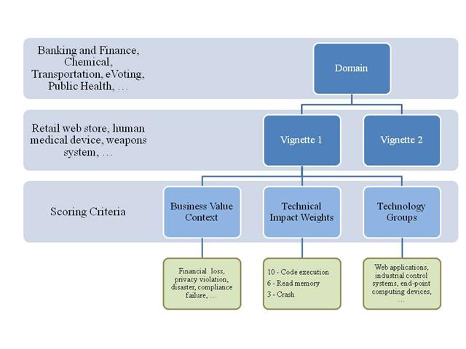
CWSS Framework: Providing Business Value Context
Web Applications, End-point Computing Devices, Cloud Services, etc
Technology Group 1
Technology Group 2
Provides a focus for education and training

Slide 9
Why Johnny Can’t write secure code?
Johnny, avoid these weaknesses…. Period!
Common Weaknesses Enumeration (CWE)
Johnny…learn from your mistakes
Common Vulnerabilities and Exposures (CVE)
Johnny…these are the ways of the bad guys
Common Attack Patterns Enumeration and Classification (CAPEC)
Johnny…these are ways to develop secure code
CERT secure coding guidelines
Notes:
So instead of just complaining about why Johnny can’t write secure code,
we can point Johnny to these resources
One might think, Johnny can write secure code now.

Slide 10
Poor Johnny !
CWE 650+ Weaknesses 1000+ Pages
45000+ CVE Vulnerabilities
CAPEC 300+ Attack Patterns
Countless Do’s and Don’ts
Notes:
Given the size of these enumeration, poor Johnny has a lot of guidance available but no easy way to put it to use
Creating standards is easy, adopting and using them is not !
IA professionals have the same feeling when a new 1000 page regulatory requirements document is given to them.

Slide 11

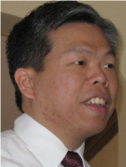

Using Semantic Templates to Study Vulnerabilities Recorded in Large Software Repositories
Me
Harvey Siy
Yan Wu
Notes:
So Today I am going to talk to you about our work in helping Johnny effectively use and adopt the standards to learn from his past mistakes.
using semantic templates to study vulnerabilities recorded in large software repositories.
Other members on this project are Yan Wu, who is a PhD student and Harvey Siy, assistant professor at the university of Nebraska Omaha.
Semantics describe things that deal with the meanings of words and sentences

Slide 12
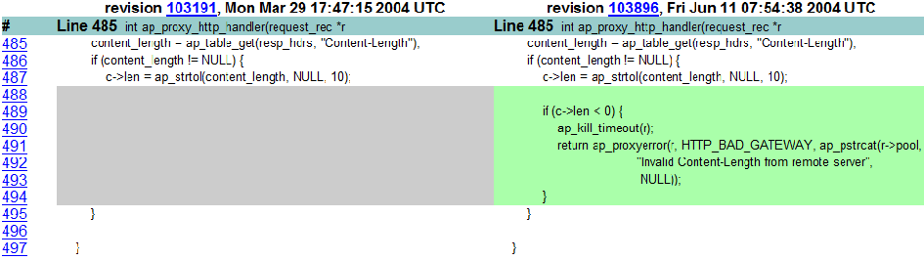
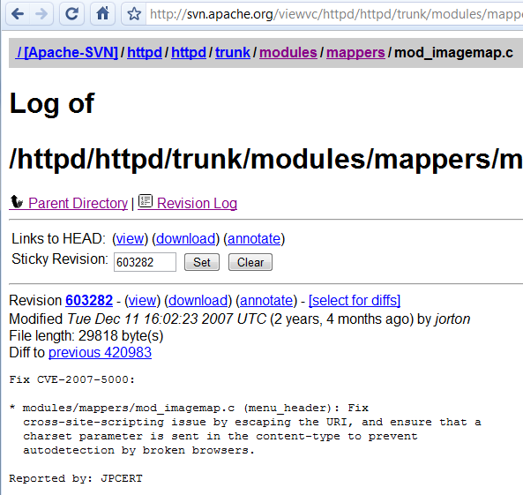
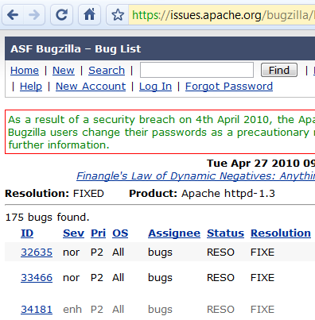
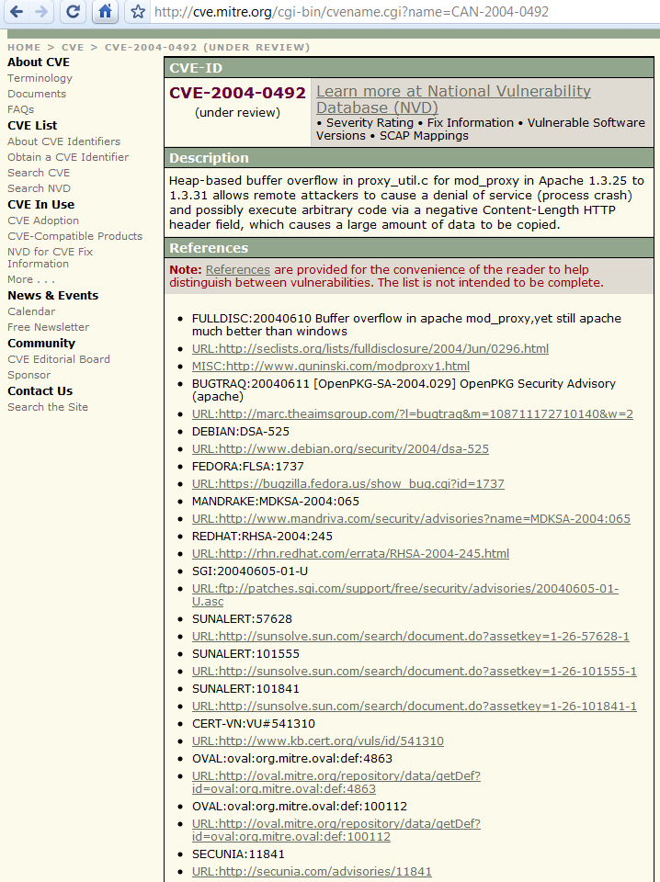
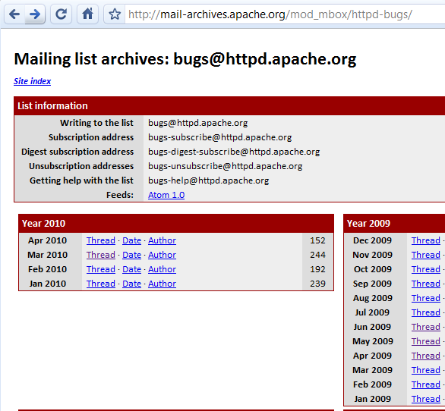
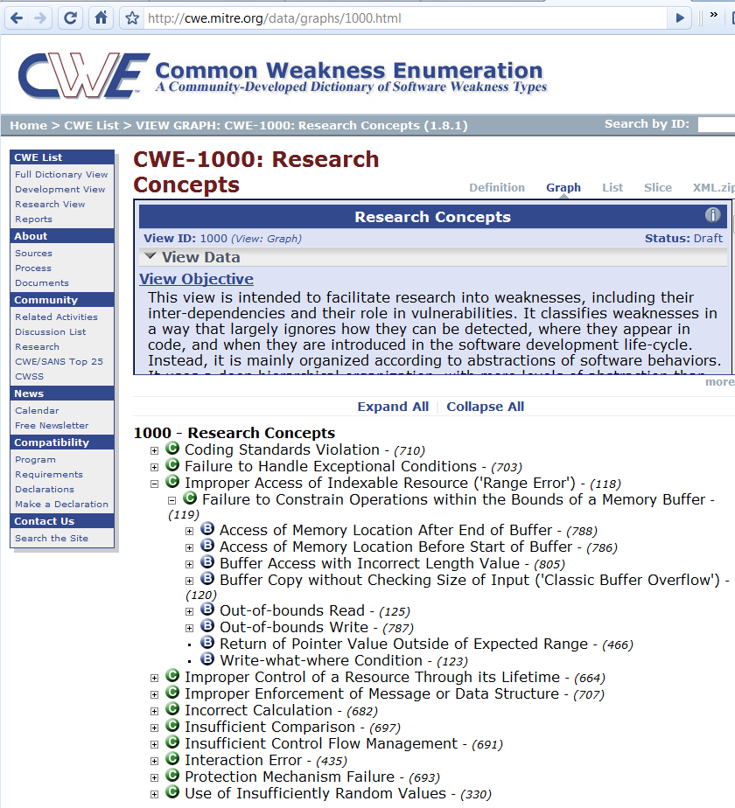
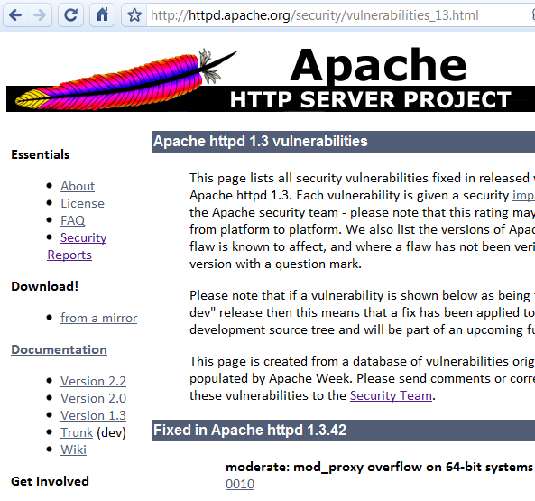
The Paradox we face !
Source Code Differences after the fix
Bug tracking databases
Log of Changes
Mailing list Discussions
Weakness Enumerations
Vulnerability Databases
Public Descriptions
Notes:
When it comes to security vulnerabilities, we face and interesting paradox. On one end we are inundated by information about a discovered vulnerability in all its technical glory and multiple sources such as mailing list discussions around bugs, log of changes, source code diffs, bug tracking databases, weakness enumerations, vulnerability databases and public media releases.
However on the other hand there is most often a lack of security know how among the developers in the Software development lifecycle. If nobody is going to read it why collect it in the first place
Information overload: Scattered vulnerability artifacts from discovery to fix:
Log of changes in version control systems; code comments; entries in bug tracking systems; communication threads in mailing lists; vulnerability databases; weakness enumerations; attack patterns
Lack of information: Security know how among project stakeholders

Slide 13
Concept Extraction
Notes:
At the end of the extraction process, a workshop is held to conslidate the results from multiple researchers applying the four strategies, to come up with a coherent set of entries to be considered.
Figure 3 speaks volumes about the complexity of the “mental model” that developers need to be aware of to understand the consequences of their coding and design decisions. Although hyperlinked, navigating the CWE documentation and various graphical representations is tedious and non-intuitive. While different CWE views help to accommodate multiple perspectives, it adds an additional layer of complexity. The CWE is comprehensive; however the current nested structure and tangled contents are confusing.

Slide 14
Tangling of information in the CWE
CWE-119: Failure to Constrain Operations within the Bounds of a Memory Buffer
The software performs operations on a memory buffer, but it can read from or write to a memory location that is outside of the intended boundary of the buffer.
Certain languages allow direct addressing of memory locations and do not automatically ensure that these locations are valid for the memory buffer that is being referenced. This can cause read or write operations to be performed on memory locations that may be associated with other variables, data structures, or internal program data. As a result, an attacker may be able to execute arbitrary code, alter the intended control flow, read sensitive information, or cause the system to crash.
LEGEND
Software Fault
Weakness
Resource/Location
Consequence
Notes:
However, answers to these questions are heavily tangled in current CWE descriptions.

Slide 15
Tangling of information in the CWE
CWE-120: Buffer Copy without Checking Size of Input ('Classic Buffer Overflow')
The program copies an input buffer to an output buffer without verifying that the size of the input buffer is less than the size of the output buffer, leading to a buffer overflow.
A buffer overflow condition exists when a program attempts to put more data in a buffer than it can hold, or when a program attempts to put data in a memory area outside of the boundaries of a buffer.
Buffer overflows often can be used to execute arbitrary code…
Buffer overflows generally lead to crashes
LEGEND
Software Fault
Weakness
Resource/Location
Consequence
Notes:
119 is the parent of 120
In addition, since these aspects are not modularized they are often are spread across and repeated in sibling and child categories .

Slide 16
Buffer Overflow
Notes:
An what results is a easy to understand an navigable template that helps to clearly understand the buffer overflow weakness, the flaws that precede the weakness, the resources that the weakness affects and its consequences. Notice that each concept is still traceable to the original CWE concepts.
It also becomes very easy to see what is missing here.

Slide 18
Experiment
The scenario…
A newbie programmer or occasional contributor to open source project
How much effort does it take to study a vulnerability and summarize lessons learned?
30 Computer Science students from a senior-level undergraduate Software Engineering course.
None to more than 5 years
No prior knowledge of semantic templates

Slide 19
Experiment
H1₀:
There is no reduction in completion time for subjects who use semantic templates compared to those who do not.
H2₀:
There is no improvement in accuracy of understanding of vulnerabilities for subjects who use semantic templates compared to those who do not.

Slide 20
Variables
The experiment manipulated these independent variables:
Group - refers to the group assigned (1 or 2).
Round - refers to the experiment round (1 or 2).
Vulnerability ID - the vulnerability under study (1-1, 1-2, 1-3, 2-1, 2-2, 2-3).
These self-reported subject variables were collected:
Programming skill level
Reading comprehension and writing skill levels - ability to read and write technical English documents.

Slide 21
Variables
Dependent variables :
Time to complete assignment
CWE identification accuracy
Fault identification accuracy
a score (scale of 1-5) on the accuracy of the identification of the software fault that led to the vulnerability
Failure identification accuracy
a score (scale of 1-5) on the accuracy of the description of the nature of the vulnerability (the manifested problem, the resources impacted and the consequences)

Slide 22
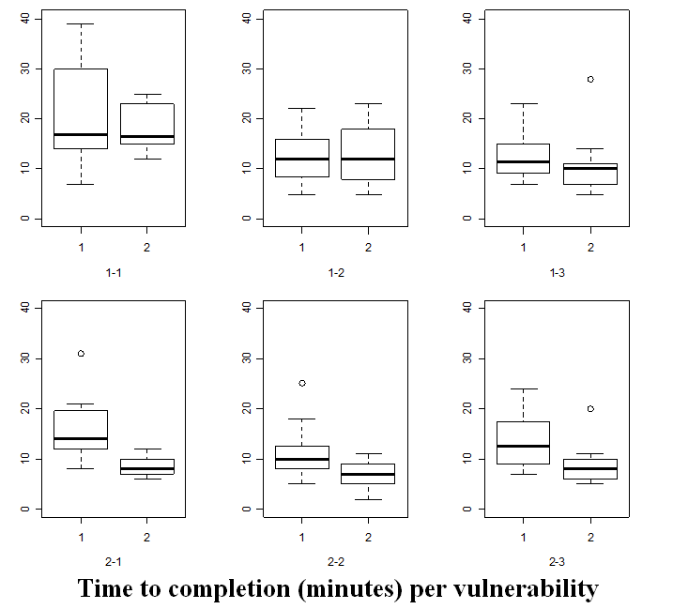
Initial Results and Findings

Slide 23
Future Work
Integrate with existing static and dynamic analysis tools to enhance reporting capabilities
Provide layers of guidance to a developer upon detection of a software flaw
Organize and retrieve knowledge of past vulnerabilities
Verify patch submissions
Investigate project/developer specific coding errors and vulnerability fix patterns
Other usage scenarios in the SDLC
Notes:
In addition to creating more templates we also want to explore the following directions in the future.

Slide 24
Acknowledgement
This research is funded in part by Department of Defense (DoD)/Air Force Office of Scientific Research (AFOSR), NSF Award Number FA9550-07-1-0499, under the title “High Assurance Software”

